Slide 1
Key Messaging for the
COVID-19 Vaccine
12/30/2020

Slide 2
Vaccine Messaging and Education

Slide 3
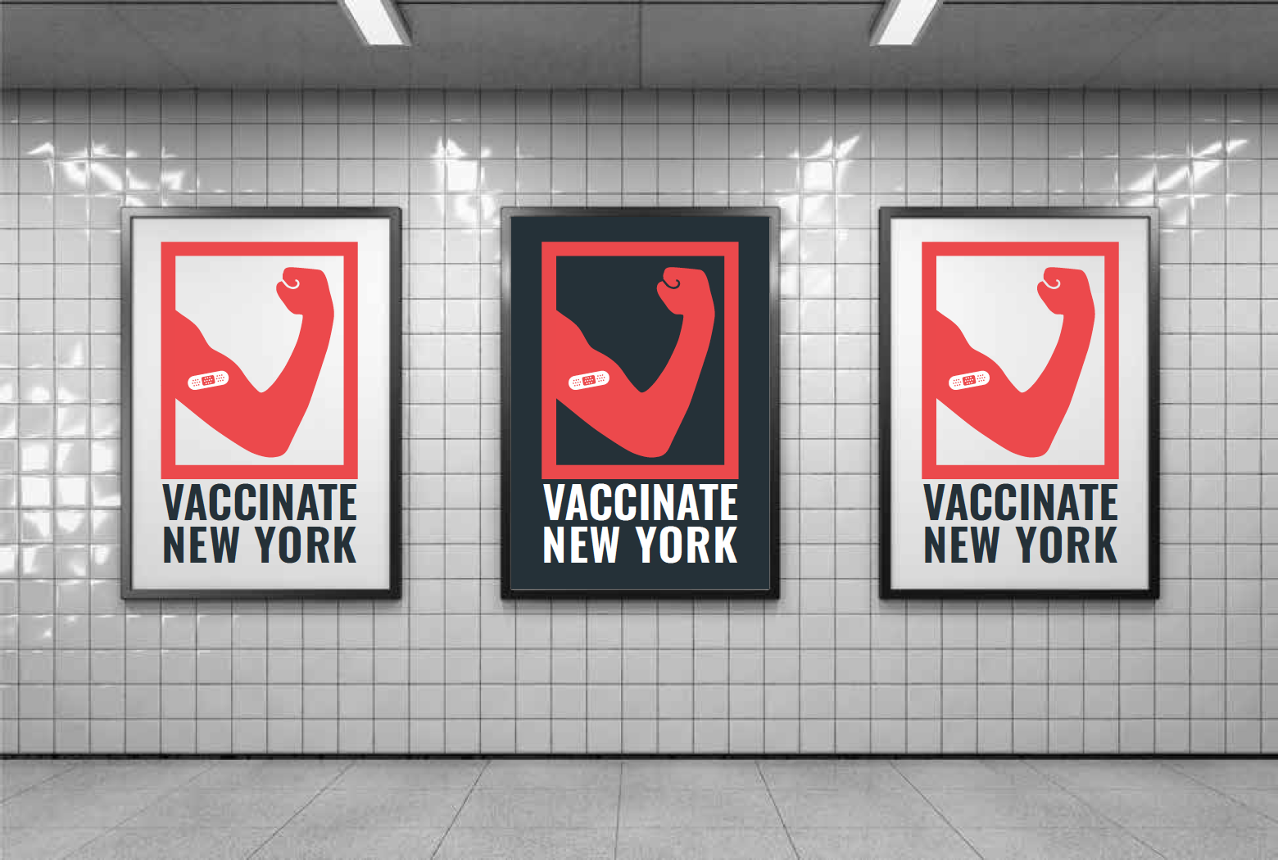
Vaccine Messaging and Education

Slide 4
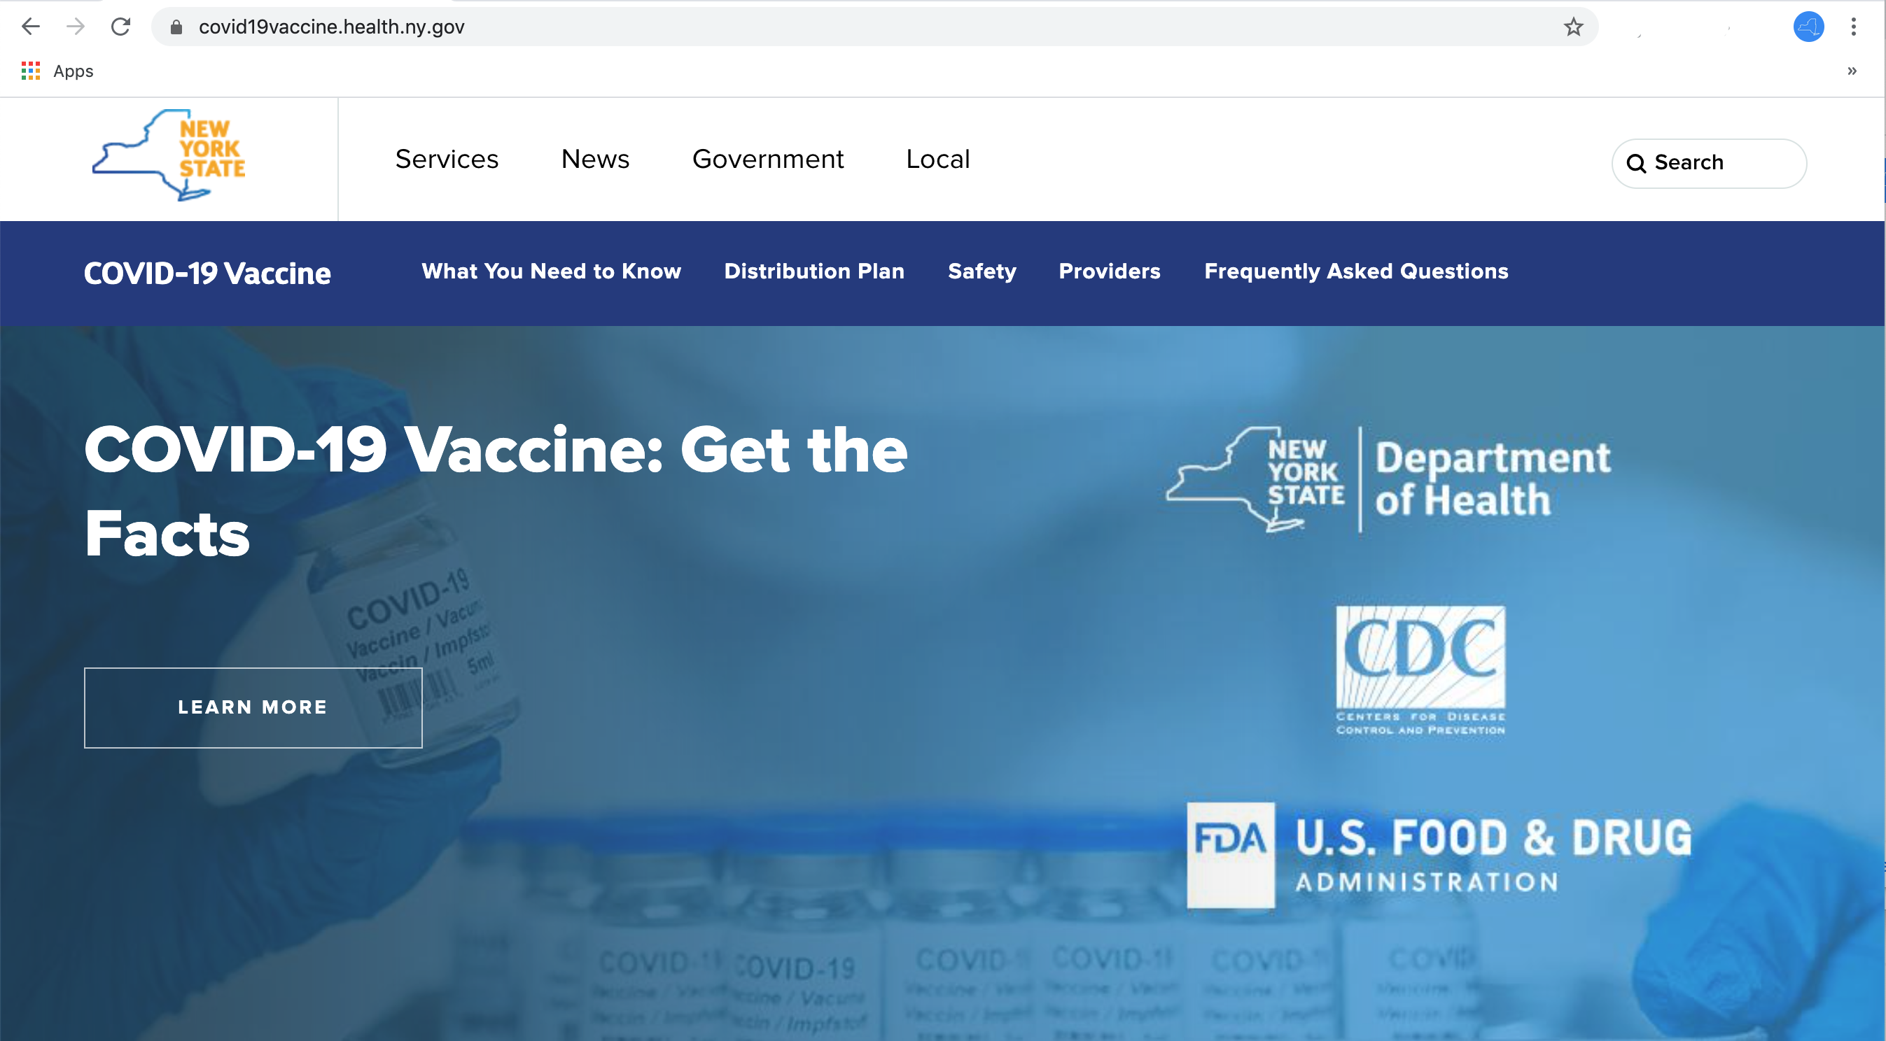
Vaccine Messaging and Education
Get the facts at ny.gov/vaccine

Slide 5
Vaccine Messaging and Education
Safe
Effective
Equitable
Approved by FDA, CDC and NYS Clinical Advisory Task Force
Backed by clinical trial data
The vaccine cannot give you COVID
Over 94+% effective
The best way to protect yourself and others from COVID-19
Our weapon to end the war
Vaccine distribution will be fair and equitable
NYS will reach out to underserved communities
Every New Yorker will be able to have access to vaccine at no cost

Slide 6
Vaccine Messaging and Education
The COVID-19 vaccines are safe.
The COVID-19 vaccines have gone through the same rigorous review that all vaccines must follow in the U.S. As of December 30, 2020, two vaccines have been approved by the FDA: the Pfizer/BioNTech vaccine and the Moderna vaccine.
These approvals followed three rounds of clinical trials with thousands of participants with a diverse range of race, age and other demographics.
In New York, the State’s independent COVID-19 Clinical Advisory Task Force, made up of prominent health experts, also approved these COVID-19 vaccines as safe and effective.
Additionally, even after a vaccine is approved, multiple safety systems at the FDA and the CDC constantly monitor for adverse events. If an adverse event is found, it is immediately investigated to determine if it poses a true health issue.

Slide 7
Vaccine Messaging and Education
Approved by the FDA, the CDC, and New York State’s independent Clinical Advisory Task Force.
The FDA has a rigorous process that vaccine developers must go through before a vaccine can be approved
New York State’s independent COVID-19 Clinical Advisory Task Force is made up of renowned health and medical experts, and is chaired by Dr. Charles Rice, winner of the 2020 Nobel Prize in Medicine
The Clinical Advisory Task Force reviews vaccine clinical data alongside the FDA so that they can provide a thorough review that does not delay the timeline

Slide 8
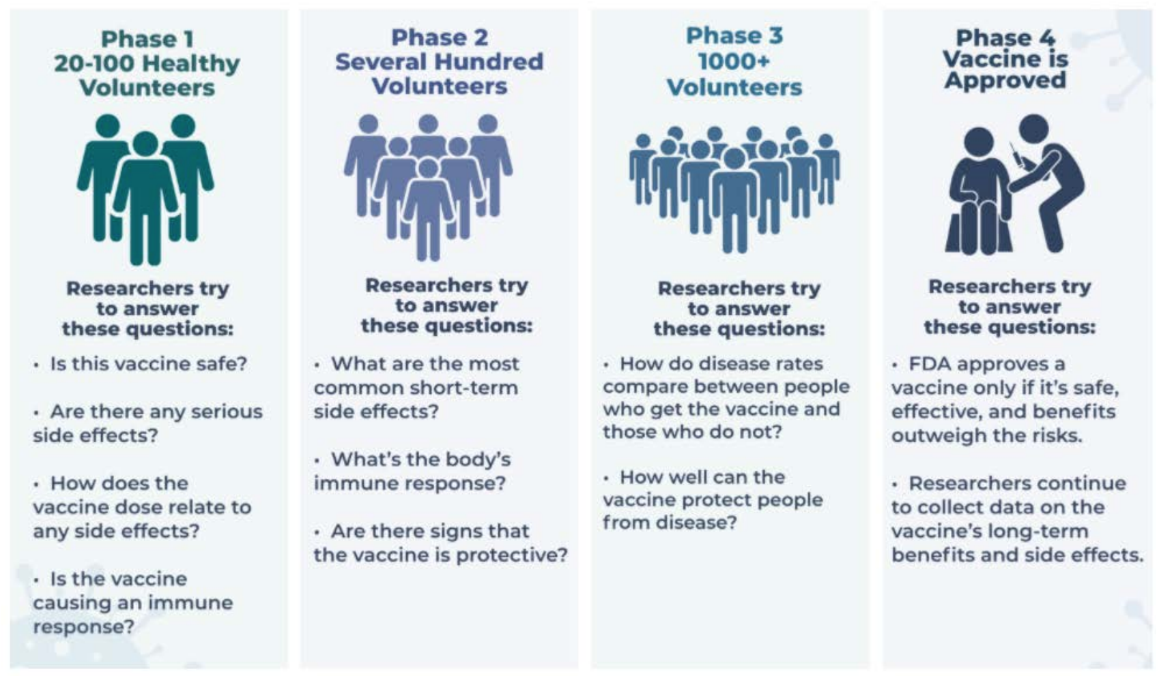
Vaccine Messaging and Education
Clinical trials:
Source: CDC

Slide 9
Vaccine Messaging and Education
Pfizer/BioNTech clinical trial info:
Phase 2/3 clinical trials had about 43,400 participants who participated at 152 clinical sites across the globe, 130 of which were in the United States.
Half of participants received the vaccine, the other half received a placebo (assigned randomly)
Demographics of participants:
49% female, 51% male
83% white
9% Black or African American
28% Hispanic or Latinx
4.3% Asian
0.5% Native American/Alaska Native
Source: New England Journal of Medicine

Slide 10
Vaccine Messaging and Education
Pfizer/BioNTech clinical trial info:
(cont.)
35% of participants were clinically obese
21% of participants had at least one coexisting condition
The median age was 52 years old
The age range of participants spanned from 16 to 91
The vaccine was found to be 95% effective at preventing COVID-19.
Source: New England Journal of Medicine

Slide 11
Vaccine Messaging and Education
Moderna clinical trial info:
Phase 3 clinical trials had about 30,400 participants from the United States
Half of participants received the vaccine, the other half received a placebo (assigned randomly)
Demographics of participants:*
48% female, 52% male
79% white
10% Black or African American
21% Hispanic or Latinx
5% Asian
0.8% American Indian/Alaska Native
*Safety Set
Source: FDA Briefing Document

Slide 12
Vaccine Messaging and Education
Moderna clinical trial info:
(cont.)
22% of participants had at least one high-risk condition
25% of participants were health care workers
Median age of 52
The age range of participants spanned from 18 to 95
The vaccine was found to be 94.5% effective at preventing COVID-19.
*Safety Set
Source: FDA Briefing Document

Slide 13
Vaccine Messaging and Education
Distribution will be equitable.
One of the key principles of New York’s vaccination program is equity and fairness
The federal government has agreed that it will not force New York State to provide any information that could be used to identify immigration status as part of the vaccination program.
New York State will work closely with partners across the state who can assist in addressing health equity issues
New York State recognizes that there is a long history of inequity and racism in health care (e.g. the Tuskegee experiment) that has led many to be understandably skeptical of government public health efforts
New York will work to address the concerns of all communities

Slide 14
Vaccine Messaging and Education
Main Reasons for Vaccine Hesitancy
“The vaccine could give me COVID.”
“The vaccine was developed too fast.”
“I’m worried about side effects.”

Slide 15
Vaccine Messaging and Education
Main Reasons for Vaccine Hesitancy
“The vaccine could give me COVID.”
“The vaccine was developed too fast.”
“I’m worried about side effects.”

Slide 16
Vaccine Messaging and Education
The vaccine cannot give you COVID.
Click here for YouTube video.

Slide 17
Vaccine Messaging and Education
The vaccine cannot give you COVID.
Facts about COVID-19 mRNA vaccines:
They cannot give someone COVID-19.
This is because mRNA vaccines do not use the live virus that causes COVID-19.
They do not affect or interact with our DNA in any way.
mRNA never enters the nucleus of the cell, which is where our DNA (genetic material) is kept. The cell breaks down and gets rid of the mRNA soon after it is finished using the instructions.
Source: cdc.gov

Slide 18
Vaccine Messaging and Education
Main Reasons for Vaccine Hesitancy
“The vaccine could give me COVID.”
“The vaccine was developed too fast.”
“I’m worried about side effects.”

Slide 19
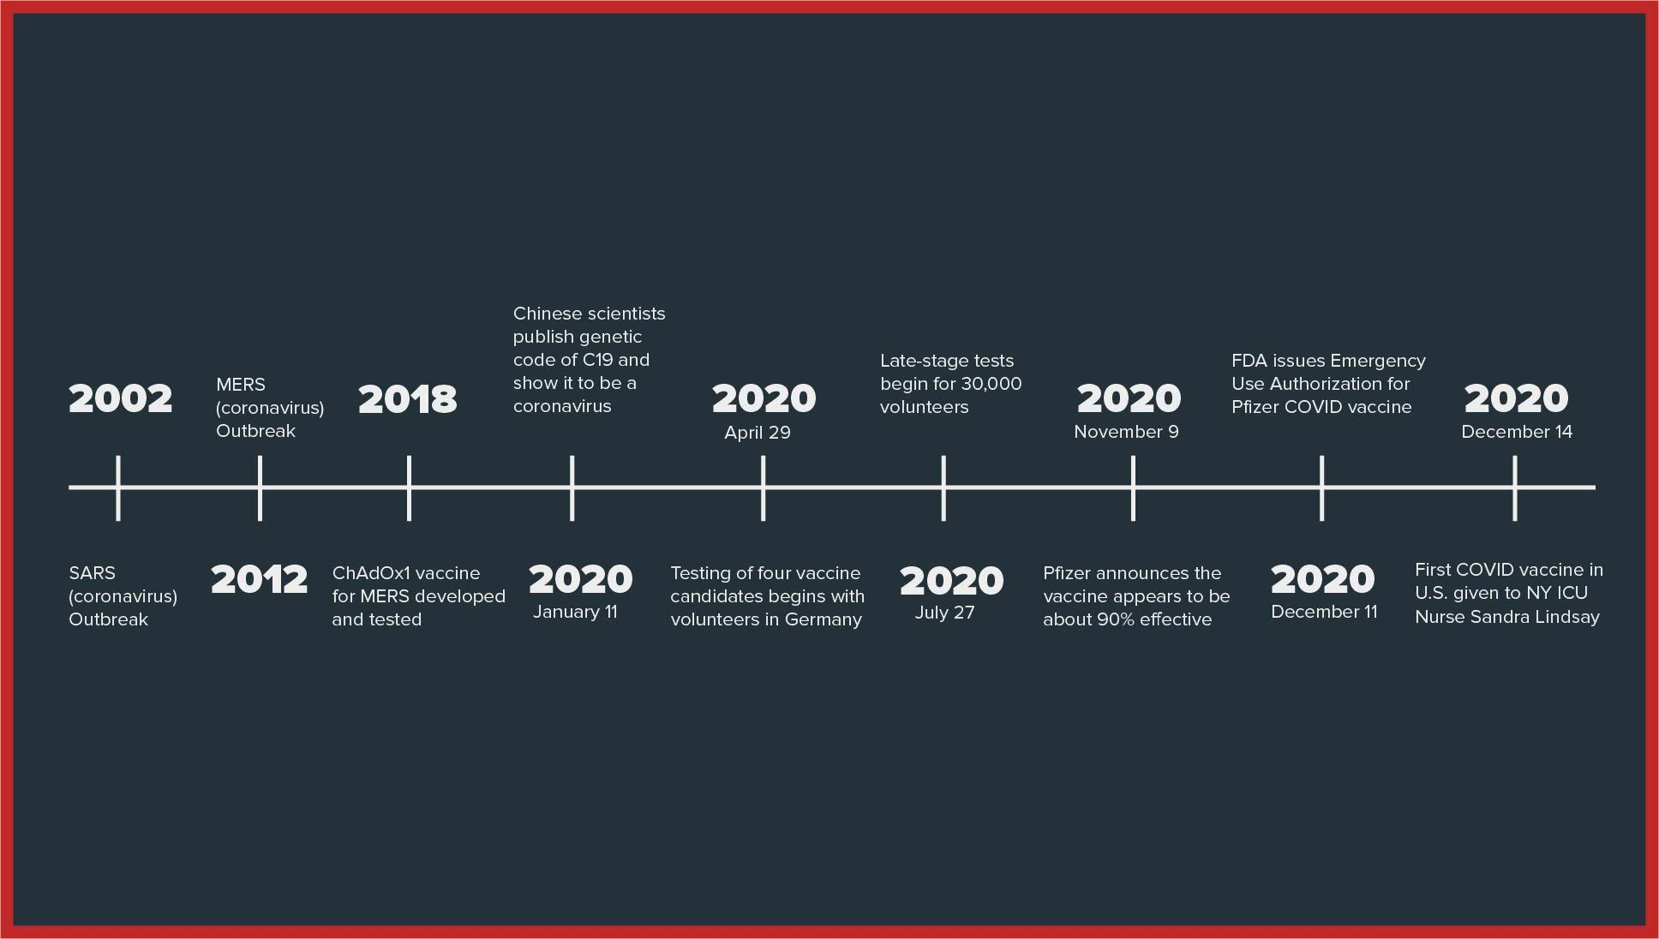
Vaccine Messaging and Education
Years of research are behind the vaccine.
TIMELINE
GOES HERE

Slide 20
Vaccine Messaging and Education
Facts about mRNA vaccines:
mRNA vaccines have been studied before for flu, Zika, rabies, and cytomegalovirus (CMV)
Research into mRNA vaccines began in 1989 and the first mRNA vaccines were developed in the 1990s
As soon as the necessary information about the virus that causes COVID-19 was available, scientists began designing the mRNA instructions for cells to build the unique spike protein into an mRNA vaccine
mRNA vaccines are being held to the same rigorous safety and effectiveness standards as all other types of vaccines in the United States
Source: cdc.gov

Slide 21
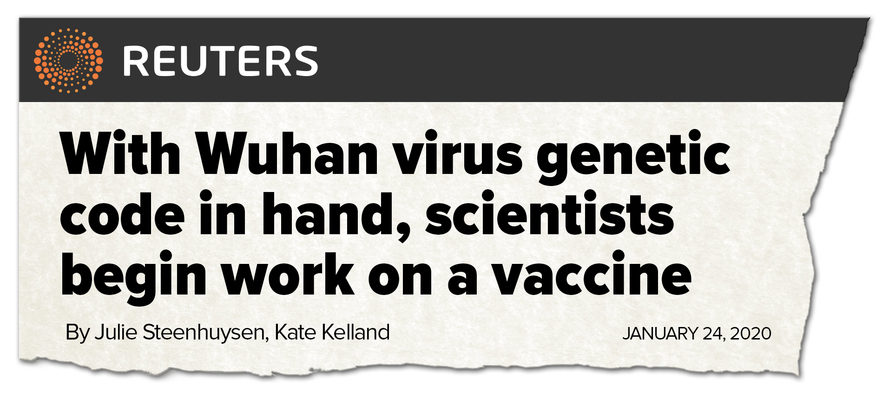
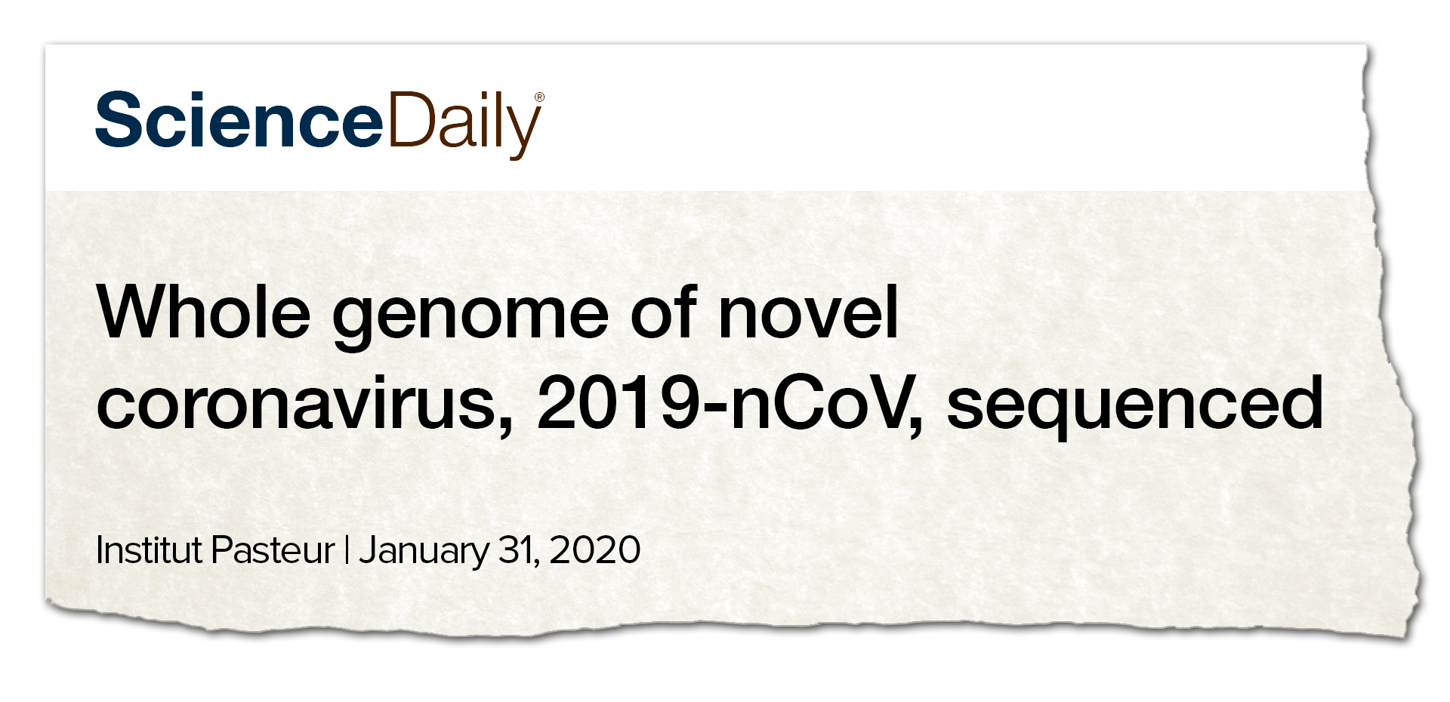
Vaccine Messaging and Education
The genetic code of the virus (2019-nCoV) was first published in January 2020 by Chinese scientists, who made the research public to the global scientific community
French scientists also sequenced the entire genome of the virus in January 2020
This meant scientists around the world could almost immediately begin developing a vaccine for the virus

Slide 22
Vaccine Messaging and Education
Main Reasons for Vaccine Hesitancy
“The vaccine could give me COVID.”
“The vaccine was developed too fast.”
“I’m worried about side effects.”

Slide 23
Vaccine Messaging and Education
No serious side effects of the vaccine have been observed in clinical trials.

Slide 24
Vaccine Messaging and Education
It is normal for your body to have an immune response after being vaccinated.
This is a sign that the vaccine is working.
IMAGE?
“Side Effects”
“Immune Response”

Slide 25
Vaccine Messaging and Education
Distribution?
The CDC’s Advisory Committee on Immunization Practices calls for:
Phase 1a:
High-risk hospital workers (emergency room workers, ICU staff & Pulmonary Department staff)
Nursing home residents and staff
Federally Qualified Health Care Center employees
EMS workers
Coroners, medical examiners and certain funeral workers
Staff and residents at OPWDD, OMH and OASAS facilities
Urgent Care Center employees
Individuals administering COVID-19 vaccines, including local health department staff
Phase 1b:
Essential workers and adults in the general public aged 75+
Updated information will be available at ny.gov/vaccine

Slide 26
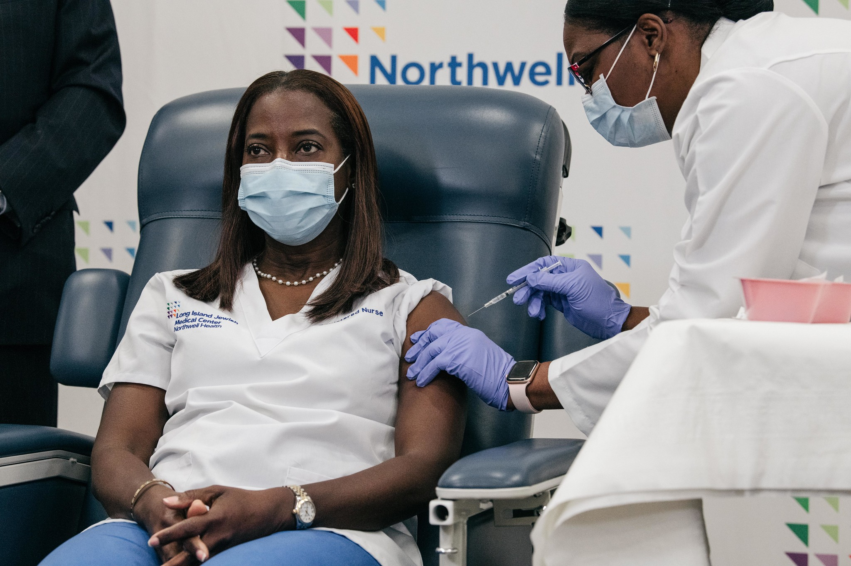
Vaccine Messaging and Education
Distribution?
Phase 1a has begun.
Phase 1b is not expected to begin until around the end of January.
Updated information will be available at ny.gov/vaccine

Slide 27
Vaccine Messaging and Education
Don’t throw out your mask yet.
COVID-19 vaccines are just one of many important tools to help us stop this pandemic.
It’s important for everyone to continue using all the tools we have to combat COVID as the vaccine becomes more available over time.
Wear a mask, social distance, avoid gatherings and wash your hands frequently. Taking these steps will still be a great way to protect yourself and others.

Slide 28
Vaccine Messaging and Education
Join the conversation on social media:
#VaccinateNY

Slide 29
Vaccine Messaging and Education
Thank you.

Slide 30
Vaccine Messaging and Education
Additional resources:
NYS COVID-19 vaccine website: www.ny.gov/vaccine
NYS Department of Health Frequently Asked Questions: https://covid19vaccine.health.ny.gov/frequently-asked-questions
CDC’s Frequently Asked Questions: https://www.cdc.gov/coronavirus/2019-ncov/vaccines/faq.html
CDC webpage on ensuring COVID-19 vaccine safety: https://www.cdc.gov/coronavirus/2019-ncov/vaccines/safety.html
CDC’s “8 Things to Know about the U.S. COVID-19 Vaccination Program”: https://www.cdc.gov/coronavirus/2019-ncov/vaccines/8-things.html
CDC explainer on mRNA vaccines: https://www.cdc.gov/coronavirus/2019-ncov/vaccines/different-vaccines/mrna.html
CDC guide with key facts on COVID-19 vaccines: https://www.cdc.gov/coronavirus/2019-ncov/vaccines/vaccine-benefits/facts.html
CDC guide explaining how COVID-19 vaccines work: https://www.cdc.gov/coronavirus/2019-ncov/vaccines/different-vaccines/how-they-work.html
CDC guide explaining the benefits of the COVID-19 vaccine: https://www.cdc.gov/coronavirus/2019-ncov/vaccines/vaccine-benefits.html
FDA webpage explaining the vaccine development process:
https://www.fda.gov/vaccines-blood-biologics/development-approval-process-cber/vaccine-development-101
General vaccine safety information from the CDC: https://www.cdc.gov/vaccinesafety/index.html
Explanation of the FDA’s Emergency Use Authorization: https://www.fda.gov/vaccines-blood-biologics/vaccines/emergency-use-authorization-vaccines-explained
Video explainer of the FDA’s Emergency Use Authorization: https://www.youtube.com/watch?v=iGkwaESsGBQ
CDC communications toolkit for medical centers, clinics and clinicians: https://www.cdc.gov/vaccines/covid-19/health-systems-communication-toolkit.html

